Slide 1
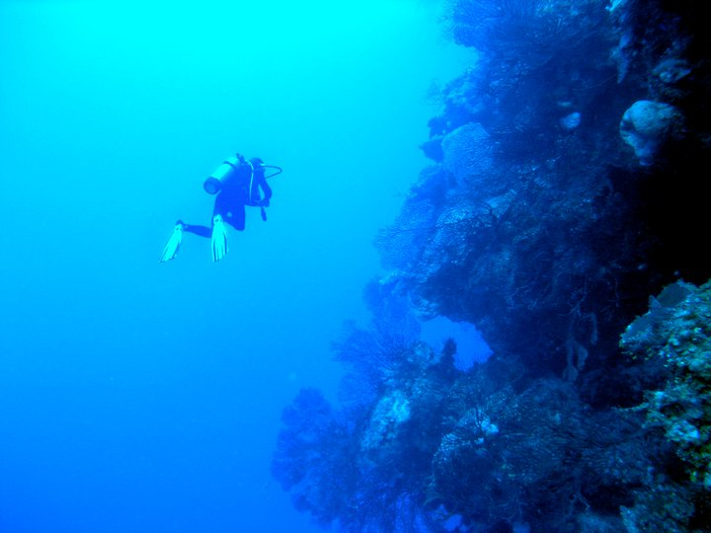
About
Courses /Specialties
Private Charter
Contact
Ricky is the best Divemaster who I’ve had the pleasure to dive with.
-Mathieu B., Montreal, Quebec, Canada

Slide 2
About
Courses / Specialties
Private Charter
Contact
Ricky is exactly who you want as an instructor when it comes to advancing to Divemaster.
-David B., Poughquag, New York
Special note to Ricky… he delivered his promises. Scuba is now a passion! You changed my life. You’re the best.
-Mark Andre L., Montreal, Quebec, Canada
Ricky introduced me to the ‘’no weights’’ diving system.
-Alicia A., Washington, DC
Ricky is the best Divemaster who I’ve had the pleasure to dive with.
-Mathieu B., Montreal, Quebec, Canada
…had an amazing vacation because I met amazing people, got certified by possibly the best scuba instructor ever who was patient, encouraging, reassuring and kept giving us positive reinforcement (thanks Ricky!)
-Rita K., Montreal, Quebec, Canada
Ricky worked with us in every detail to teach us safe diving skills and ensuring that we learned this amazing sport so we could be solid global dive citizens.
Ricky always made you feel safe and secure while miles out in the water.
-Michael D., Cherry Hill, NJ

Slide 3
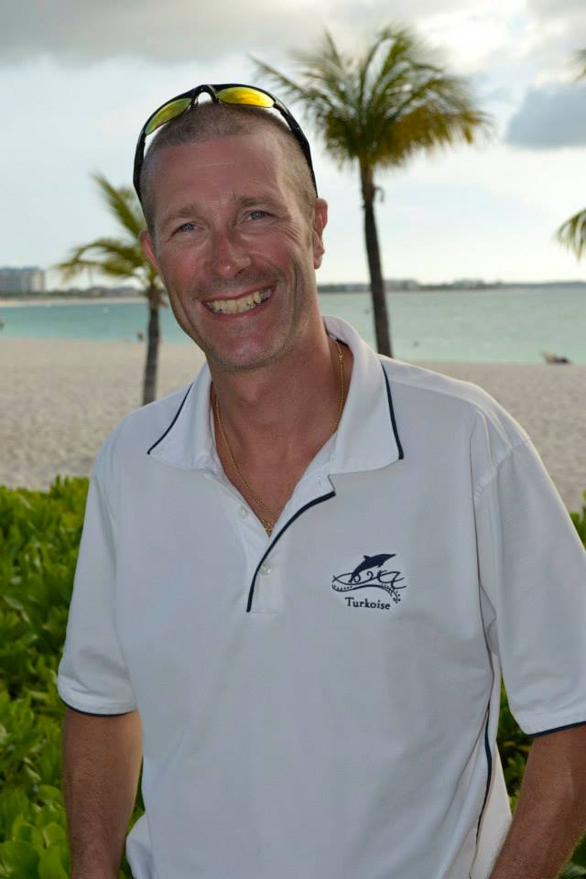



About
Courses /Specialties
Private Charter
Contact
About Ricky Lajoie
Ricky has been scuba diving since 1989 and is also an accomplished free diver. Ricky has worked internationally with world-class dive operations, giving him the opportunity to dive almost all the oceans and the seas of the world. He is credited with having completed more than 9,000 dives. Ricky’s extensive diving experience and continuous education has enabled him to develop his own unique methods of coaching, providing divers of all levels with a symbiotic experience with the element.
Qualifications
Ricky has trained with multiple different diving associations and is currently a member of the Professional Association of Diving Instructors (PADI) and the Confédération Mondiale des Activités Subaquatiques (CMAS). He is also a PADI staff instructor, a CMAS 2-star instructor, and an emergency first response instructor.

Slide 4
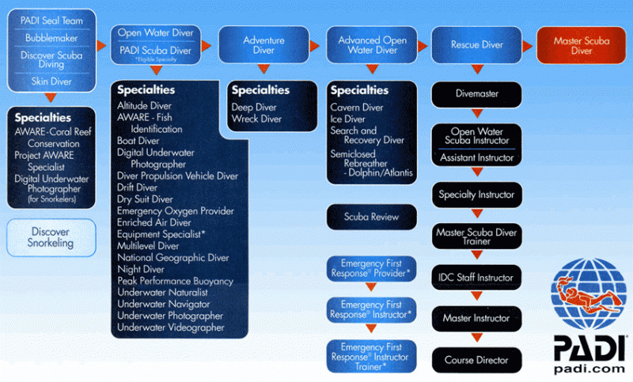
About
Courses /Specialties
Private Charter
Contact
PADI Program
As an IDC Staff Instructor, Ricky is certified to teach the entire PADI program, from Open Water Diver to Divemaster, and provide Pre-Instructor Development Course (IDC) coaching.

Slide 5
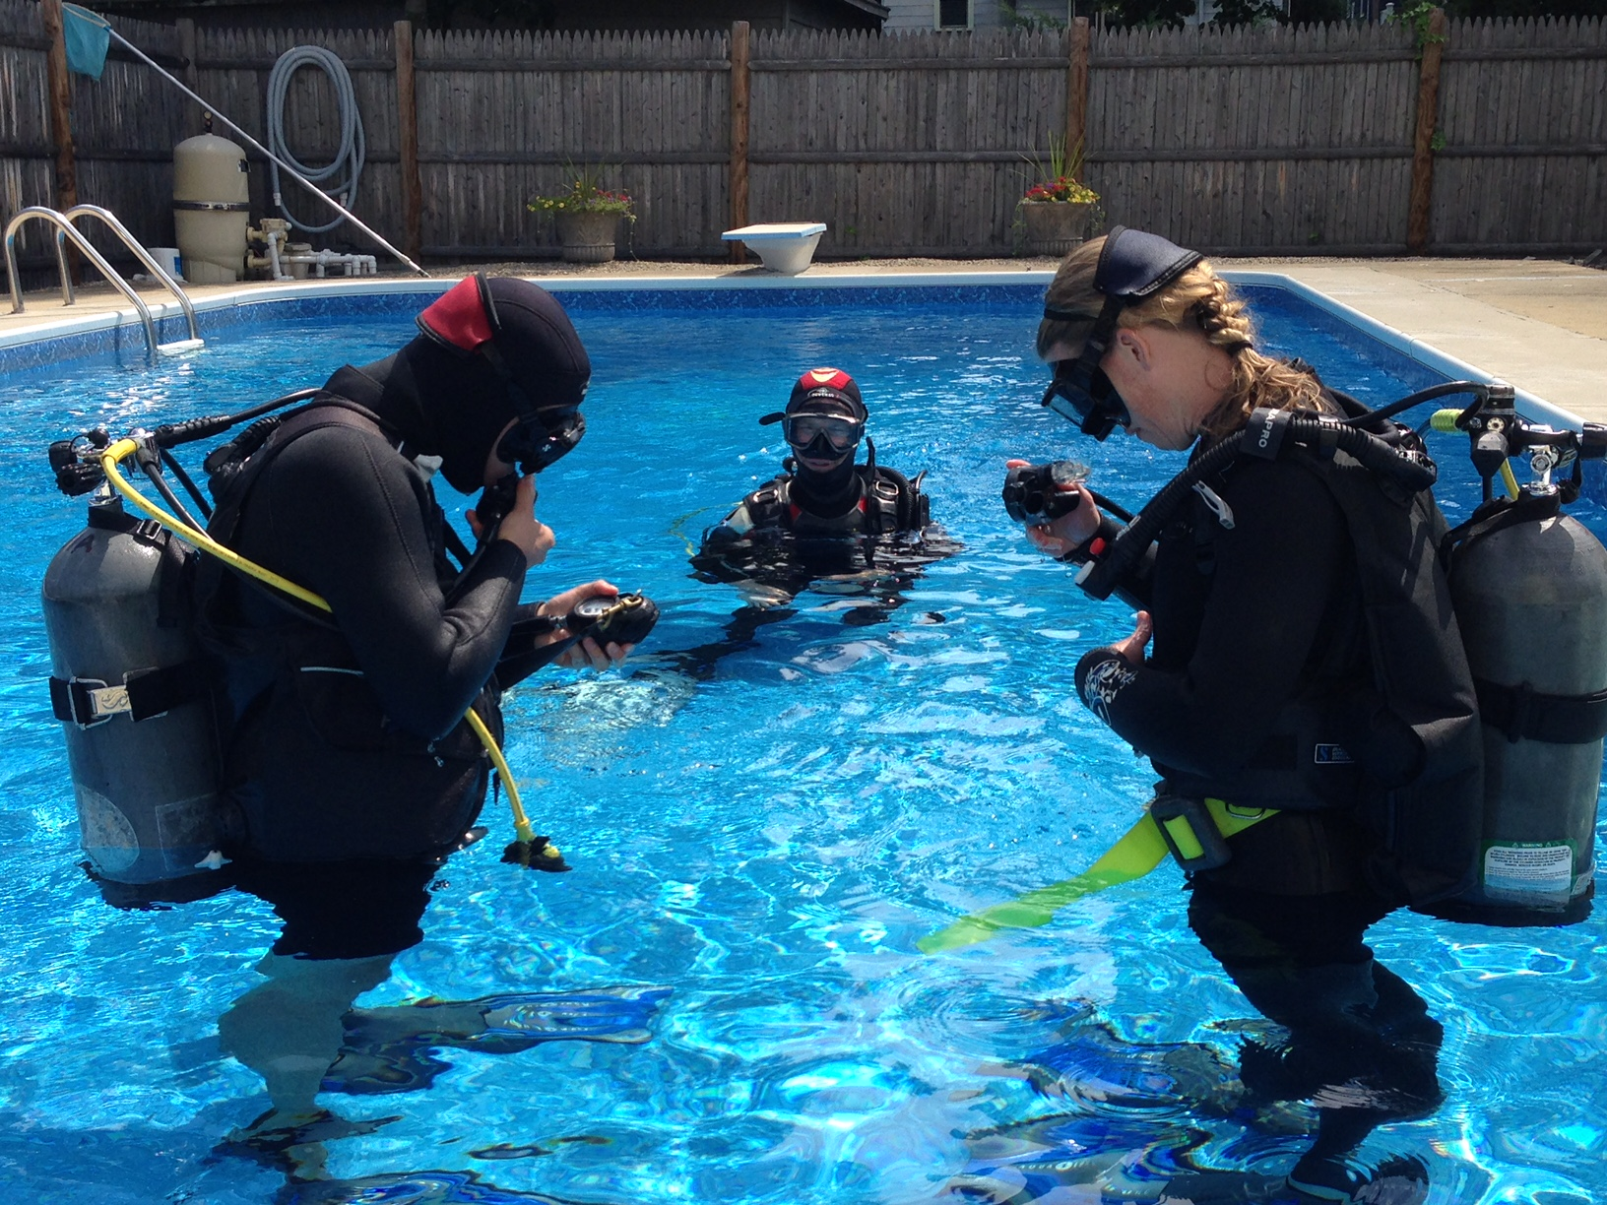
About
Courses /Specialties
Private Charter
Contact
Scuba Diving Referral Program
Students must complete the following steps to receive their PADI Open Water certification - 1) scuba diving theory; 2) pool skills; and 3) four open water dives. The referral program only focuses on the first two steps. Students must then take the referral and complete their training on their warm water vacation. Step 3 does not have to be decided at the time of training, but it must be completed within six months of the training class.
Option #1
Saturday
8AM – 12PM | Classroom Theory
1PM – 4PM | Pool Skills
Sunday
8AM – 12PM | Pool Skills
1PM – 4PM | Theory Exam
Option #2
+ Theory e-Learning via padi.com
Saturday
9AM – 12PM | Classroom Theory Review
1PM – 4PM | Pool Skills
Sunday
9AM – 1PM | Pool Skills
Includes all textbooks and all SCUBA equipment except for mask, snorkel, and fins (all students must supply their own mask, snorkel, and fins). The instructor will provide tanks, regulators, buoyancy compensators, weight belts, and wet suits. If students already own their own equipment, they are encouraged to use it in the pool.

Slide 6
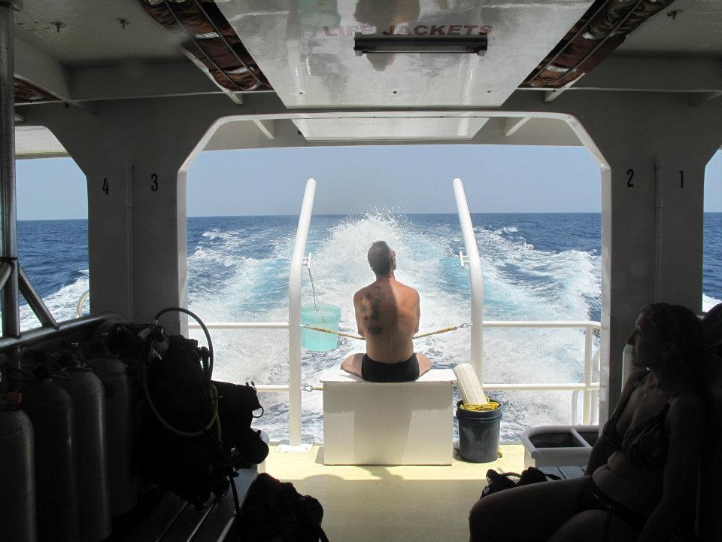
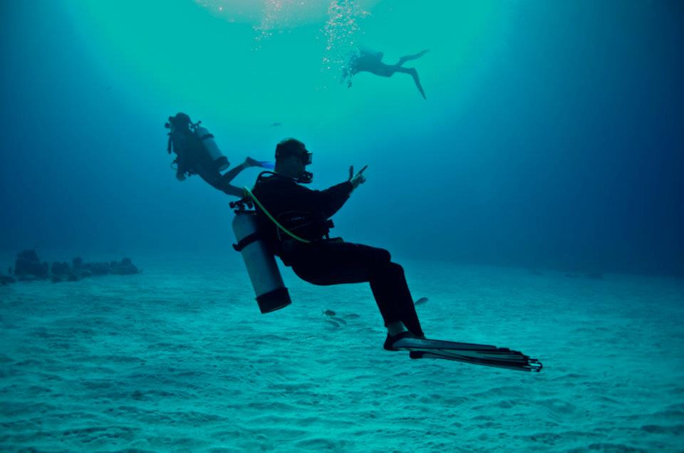
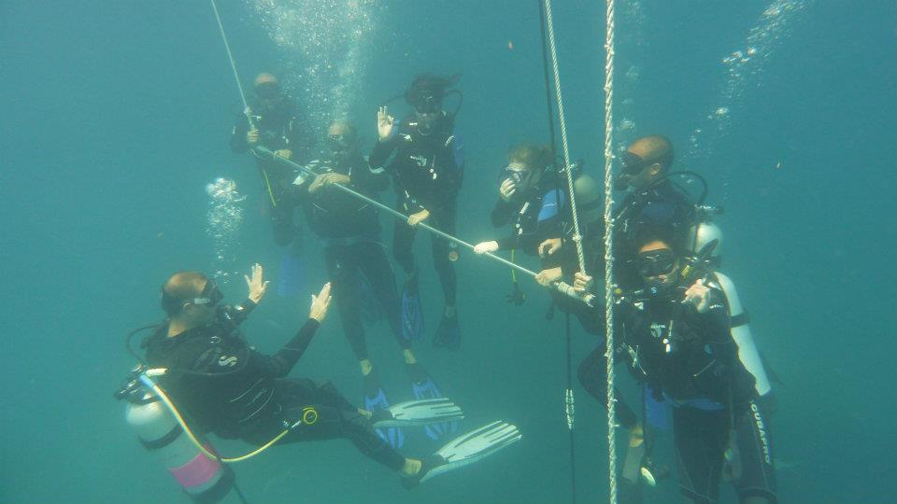
About
Courses /Specialties
Private Charter
Contact
Exclusive, safe, and relaxing ambiance
Private boat
Personalized dive lesson
Private dive tour
Pro-diving coaching
Nitrox on demand
Freediving
Snorkling
If you think you go slow, go slower – Ricky Lajoie

Slide 7
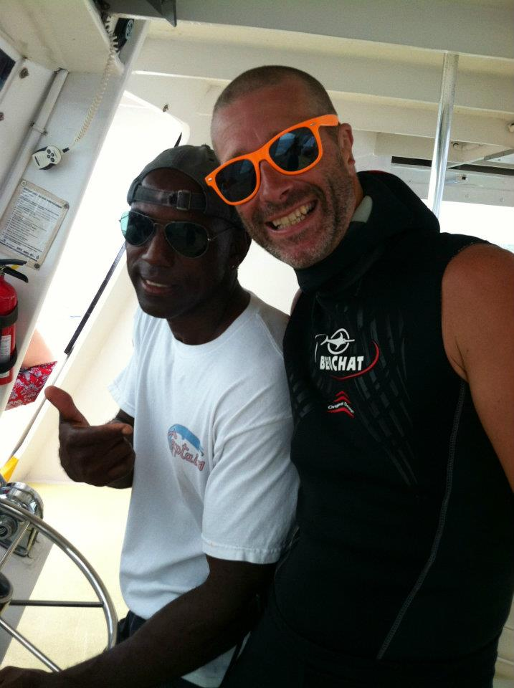
About
Courses /Specialties
Private Charter
Contact
Contact
Ricky Lajoie
508-745-3943
lajoierichard@gmail.com

